Slide 1
Mr. Bin
Commodity recycling and exchange application
Team members
1109 – Abu Jafar Saifullah
1115 – Jitesh Sureka
Supervised by
Dr. B M Mainul Hossain
Associate Professor, IIT DU

Slide 2
Introduction
Platform for connecting recyclers
Reusability of commodities
The most common unused items are
Books
Newspaper
Clothes
Plastic Items
Glassware
A user can exchange, recycle or donate commodities

Slide 3
Scope of the Project
Project Goal
Develop a webapp that creates a platform to interconnect recyclers in order to increase recycling and bring wastage and useless items in the household to a minimum.

Slide 4
Feature set of Mr. Bin
Mode of Operation
Posting Ad
Exchange
Recycle
Donation
Upload commodity information
Select Mode of operation
Contact other end user to finalize the trade
Exciting Feature
Application will have a feature, ‘object detection’ to remove spammers

Slide 5


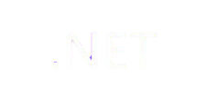
Tools to be used
React Js
MongoDB
Dot Net

Slide 6



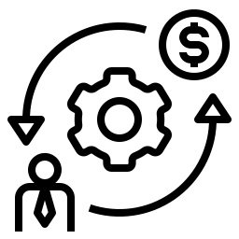

Motivation
Wastage Reduction
Recycling
Cost Reduction
Employment
ESG principles

Slide 7
Workplan

Slide 9
Team Members
1109 – Abu Jafar Saifullah
1115 – Jitesh Sureka

Slide 10
Feedback
Thank You!

